Slide 1
Plant Hardiness Zones Unique to Hawaii Climates
Ilana Stout
TCBES 670
Spring 2014

Slide 2
The Problem:
Farmers and gardeners in Hawai’i need to share information about which crop varieties perform well in specific climate conditions.
Current plant hardiness zone systems do not accurately represent the diverse growing conditions found in Hawai’i.

Slide 3
USDA Zones: Annual Minimum Temperature Only
http://planthardiness.ars.usda.gov

Slide 4
Sunset Climate Zones: Include rainfall…
…but only define 2 zones!
http://www.sunset.com/garden/climate-zones/sunset-climate-zone-hawaii

Slide 5
Hawai’i Public Seed Initiative State Variety Survey
Objectives:
Create map or maps of growing conditions in Hawai’i
Survey farmers and gardeners across the state about successful varieties
Develop interactive tool for online information sharing

Slide 6
What factors to include?
Canada’s Plant Hardiness Factors are determined by 7 factors !
Y = -67.62 + 1.734X₁ + 0.1868X₂ + 69.77X₃ + 1.256X₄ + 0.006119X₅ + 22.37X₆ - 0.01832X₇ where: Y = estimated index of suitability X₁ = monthly mean of the daily minimum temperatures (°C) of the coldest month X₂ = mean frost free period above 0°C in days X₃ = amount of rainfall (R) from June to November, inclusive, in terms of R/(R+a) where a=25.4 if R is in millimeters and a=1 if R is in inches X₄ = monthly mean of the daily maximum temperatures (°C) of the warmest month X₅ = winter factor expressed in terms of (0°C - X₁)R_{jan} where R_{jan} represents the rainfall in January expressed in mm X₆ = mean maximum snow depth in terms of S/(S+a) where a=25.4 if S is in millimeters and a=1 if S is in inches X₇ = maximum wind gust in (km/hr) in 30 years http://planthardiness.gc.ca/index
In Hawai’i, the most important factors are:
Rainfall,
Elevation ( a proxy for Temperature)

Slide 7
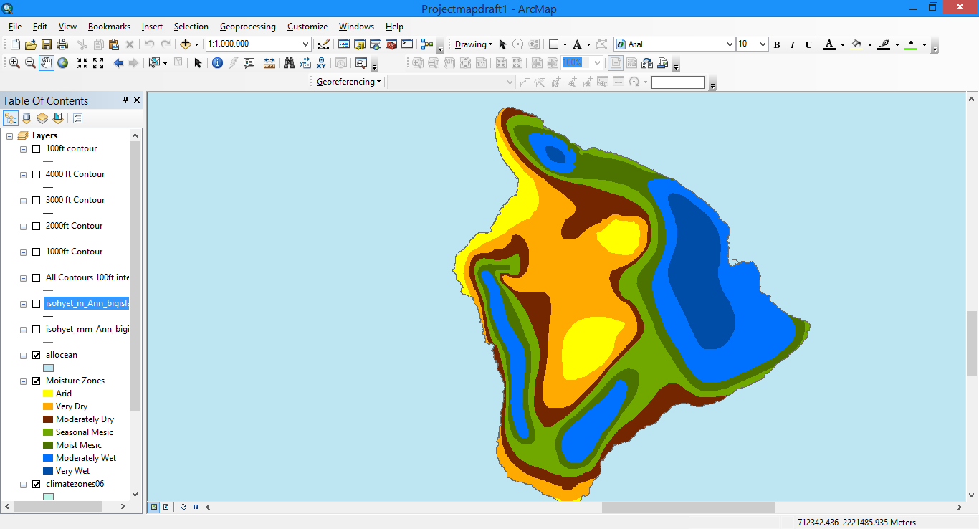
Data Set: Rainfall
Moisture zones developed for HCSU Technical Report 008: Mapping Plant Species in the Hawaiian Islands: Developing a Methodology and Associated GIS Layers
Moisture zones include both rainfall and potential evapotranspiration

Slide 8
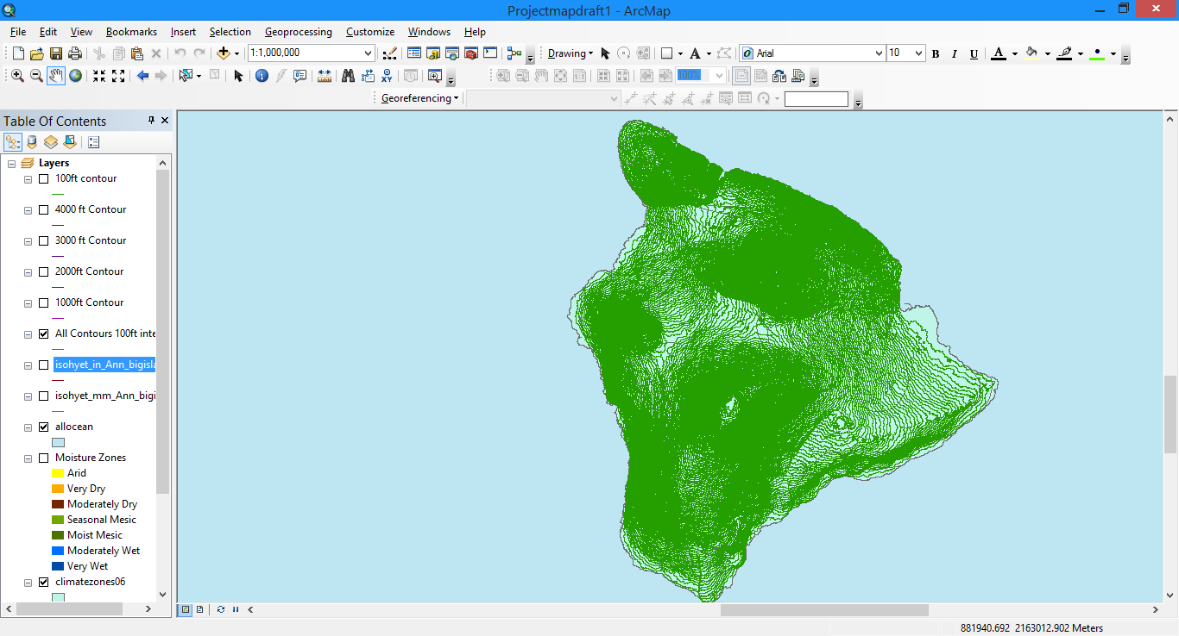
Data Set : Elevation
100ft Contours from
Office of Planning : Hawaii Statewide GIS Program

Slide 9
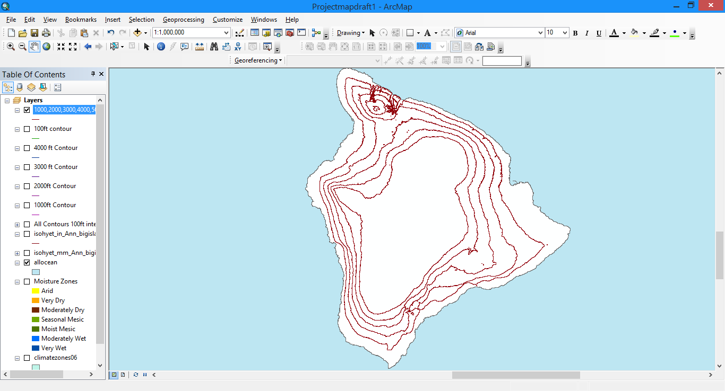
1000, 2000, 3000, 4000 ft contours

Slide 10
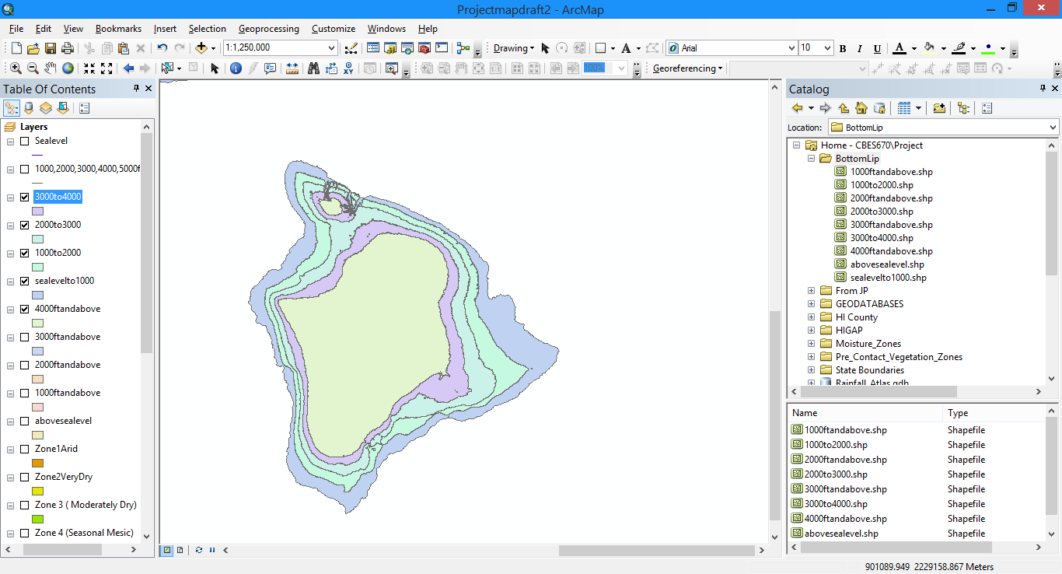
Polygons for 5 distinct elevation zones

Slide 11
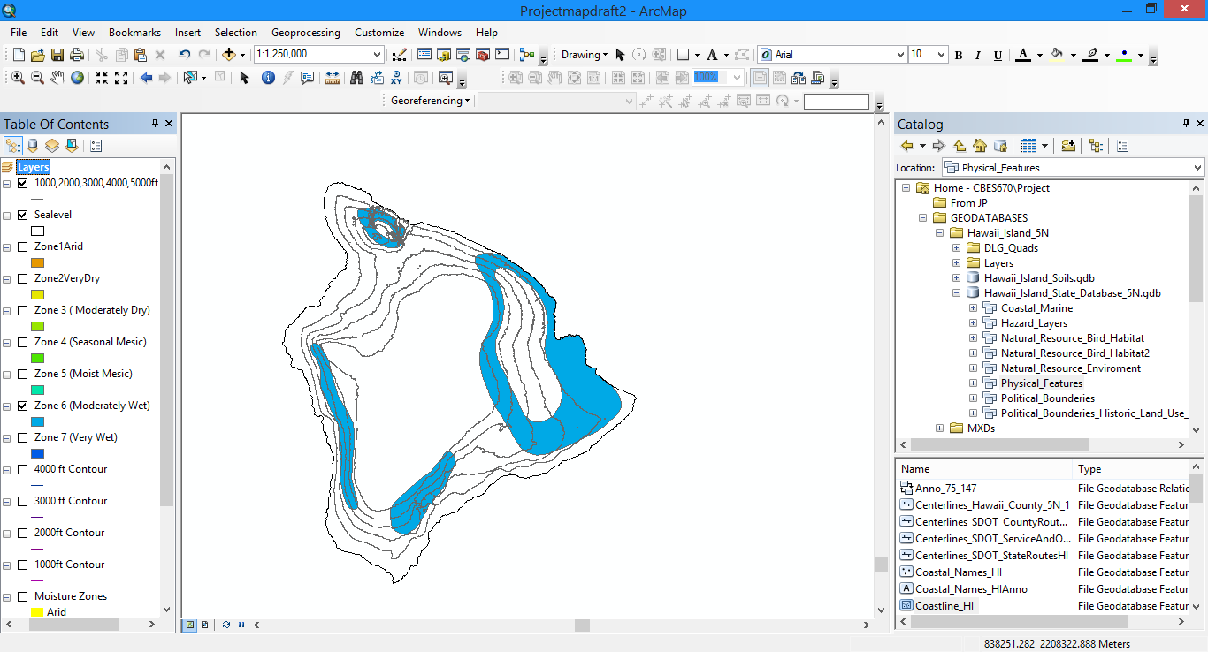
Moisture Zones Intersect with Contours

Slide 12
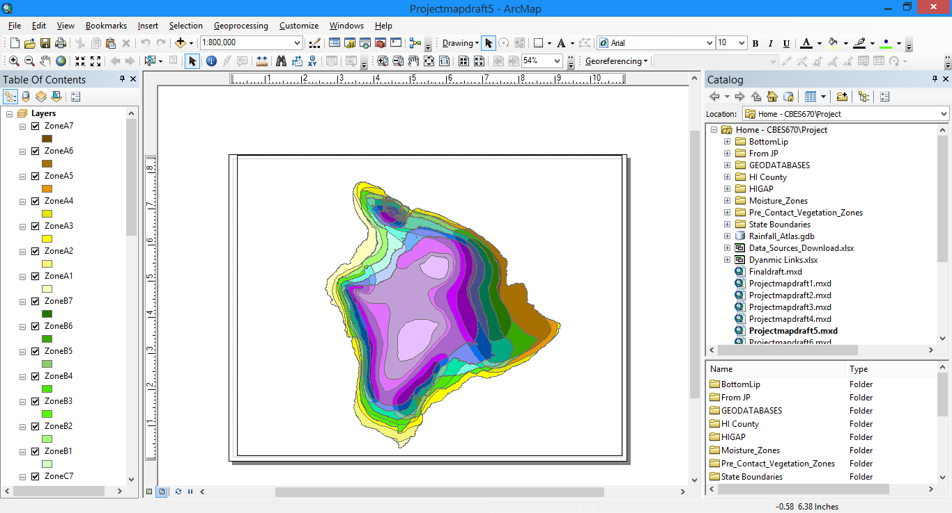
7 Moisture Zones x 5 Elevation Zones = too many zones!

Slide 13
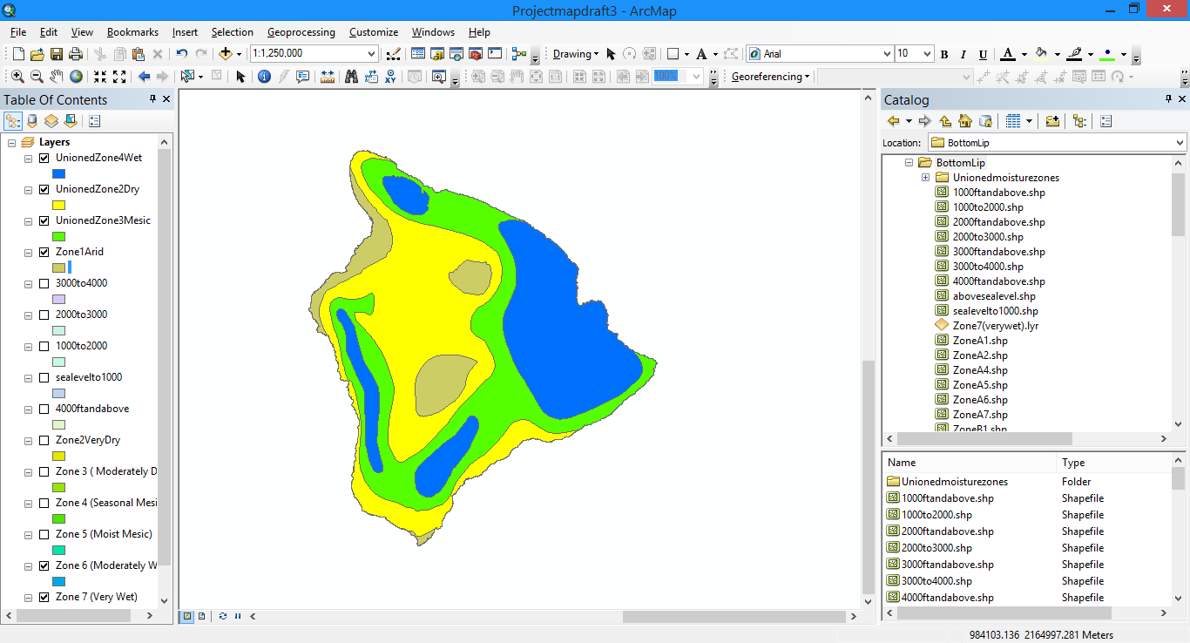
Combined Moisture Zones of Similar Type

Slide 14
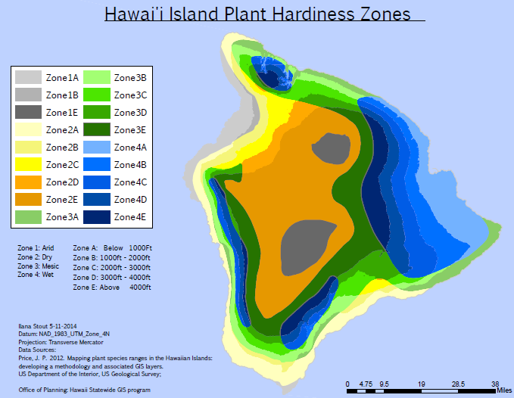

Slide 15
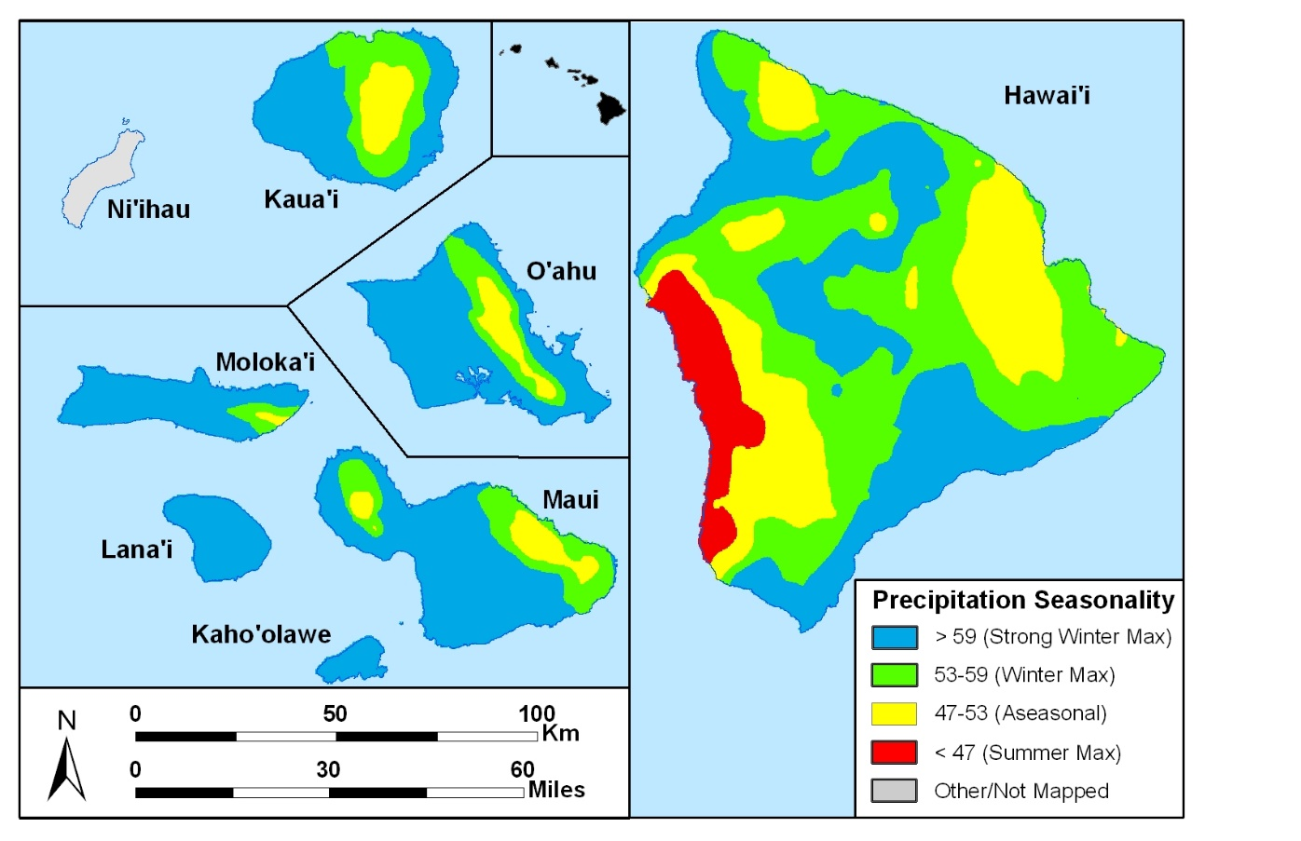
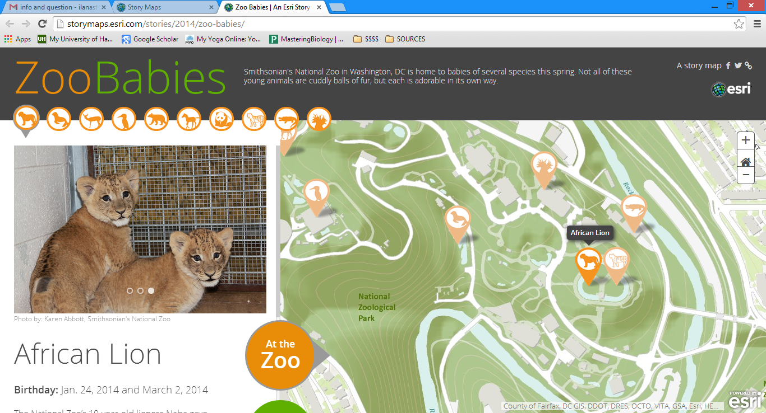
Further steps
Seasonality
Soils
Storymap
Jonathan Price

Slide 16
Refrences
Price, J. P. 2012. Mapping plant species ranges in the Hawaiian Islands: developing a methodology and associated GIS layers.US Department of the Interior, US Geological Survey

Slide 17
Suggestions?
Want to participate?
Please contact me at istout@hawaii.edu
Thanks to Dr. Ryan Perroy, Dr. Jonathan Price,
Lyn Howe and the members of the Hawaii Public Seed Initiative

