Slide 1
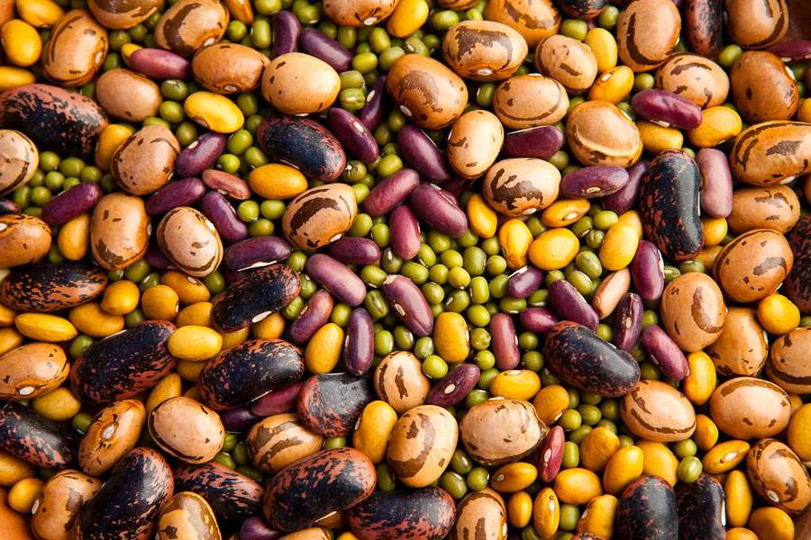
Maui Seed Savers Seed and Plant Exchange Seed Saving workshops
Evan Ryan
Elan Goldbart

Slide 2
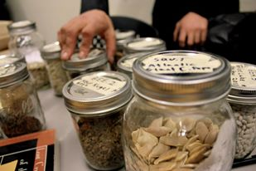
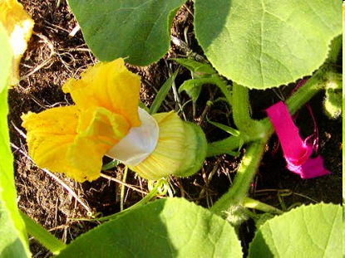
Building an Art and Culture of Seed Saving on Maui
Cultivating a movement of farmers, gardeners, and community members toward saving and stewarding seeds.
Envisioning the formation of a seed bank, seed library, or seed cooperative

Slide 3
Maui Seed Pledge
Agriculture and seeds provide the basis upon which our lives depend. We must protect this foundation as a safe and genetically stable source for future generations. For the benefit of all farmers, gardeners, and consumers, I pledge to support the right to freely save seeds. I support locally driven seed saving projects that lead to healthier soils, diverse ecosystems, as well as self-reliant and resilient communities. I pledge to support a movement of gardeners, farmers, and community members who value the preservation and stewardship of seed systems.
Can be signed by hand
Or at www.mauiseedsavers.com/mauiseedpledge
Notes:
Pass out pledge have people sign

Slide 4
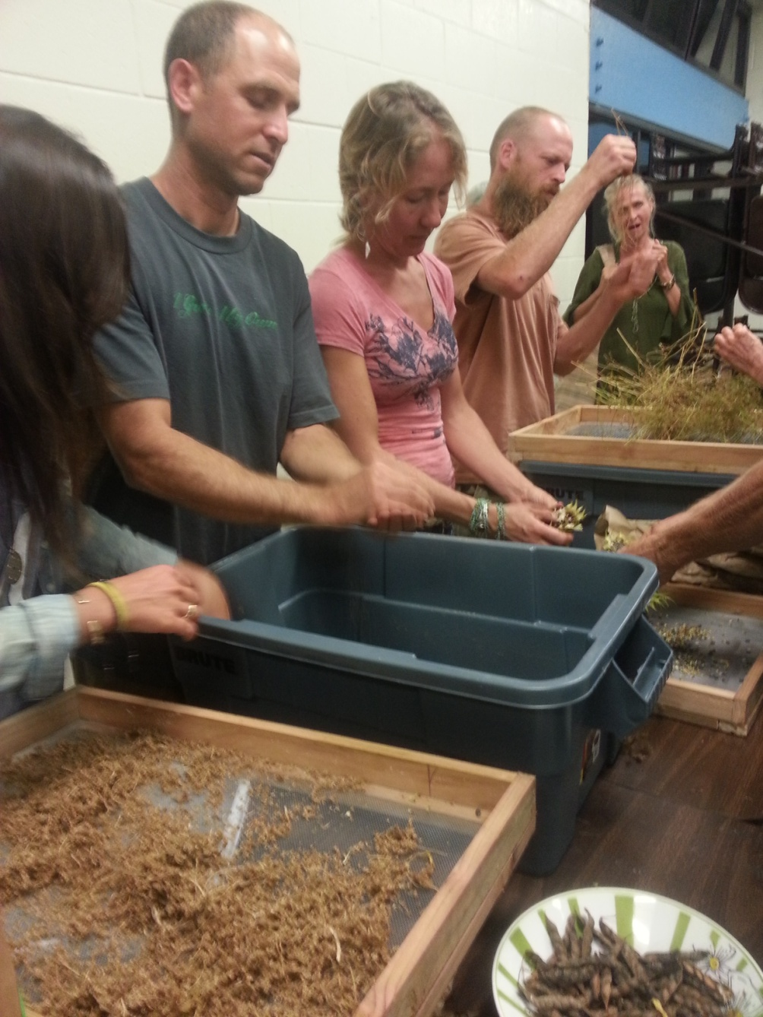
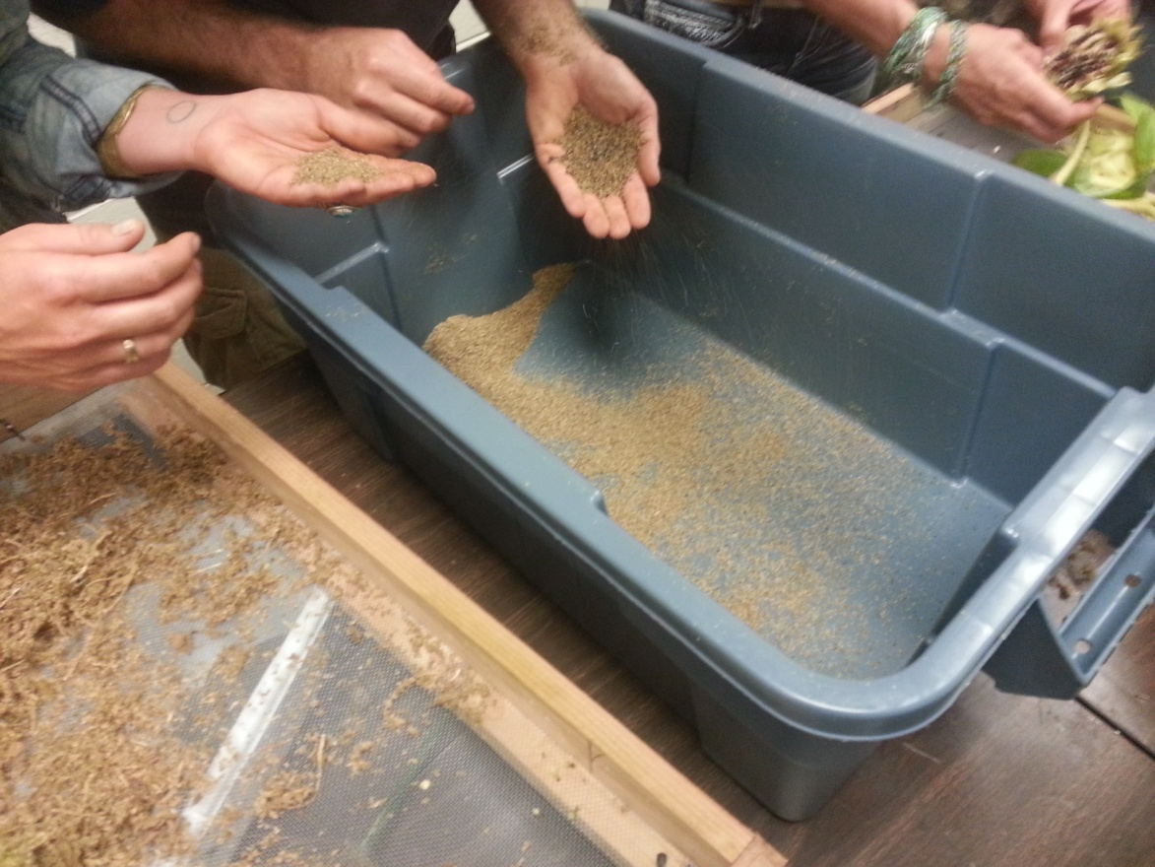
Seed Saving Workshops

Slide 5
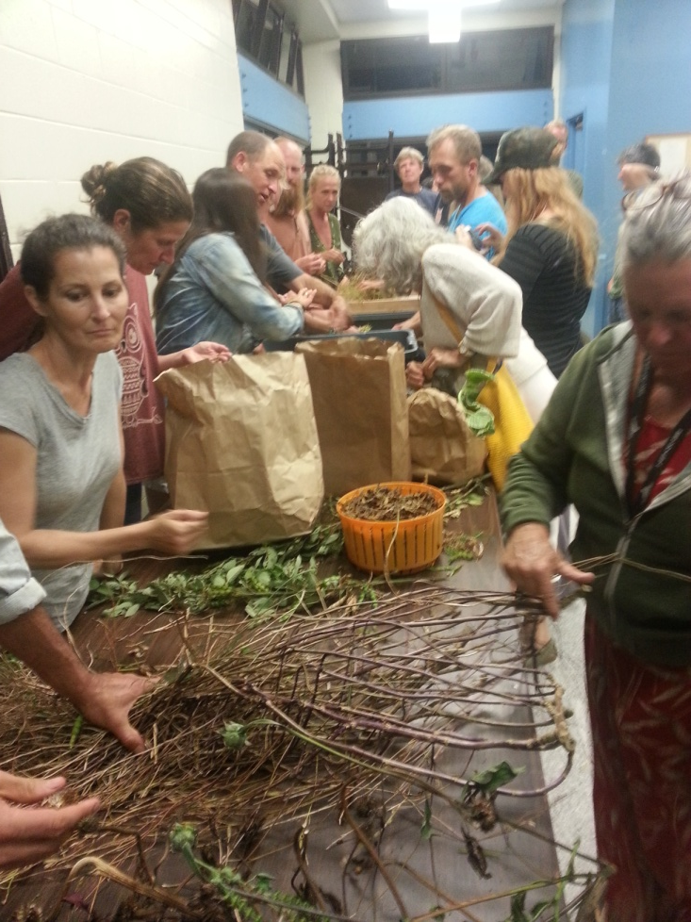
Pukalani
~30 Participants
1 hour lecture
15 minutes Q+A
45 minutes hands on and discussion

Slide 6
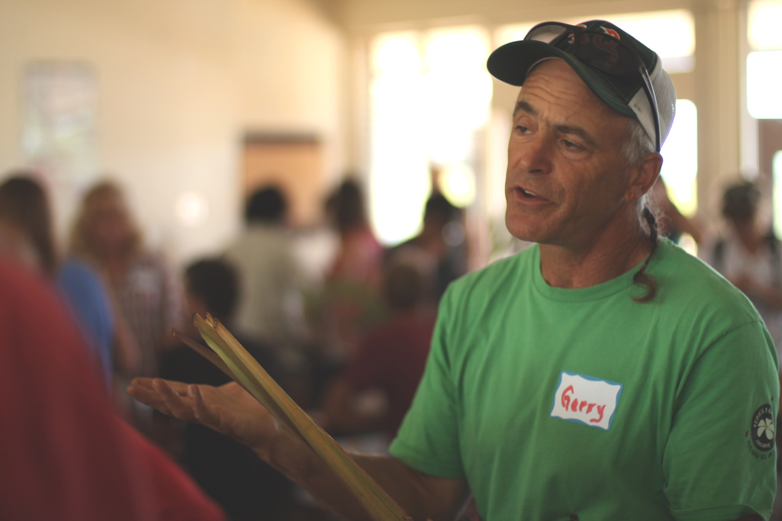
1st Maui Seed and Plant Exchange
Notes:
Lets add flyer as first slide—also add picture of seed share box

Slide 7
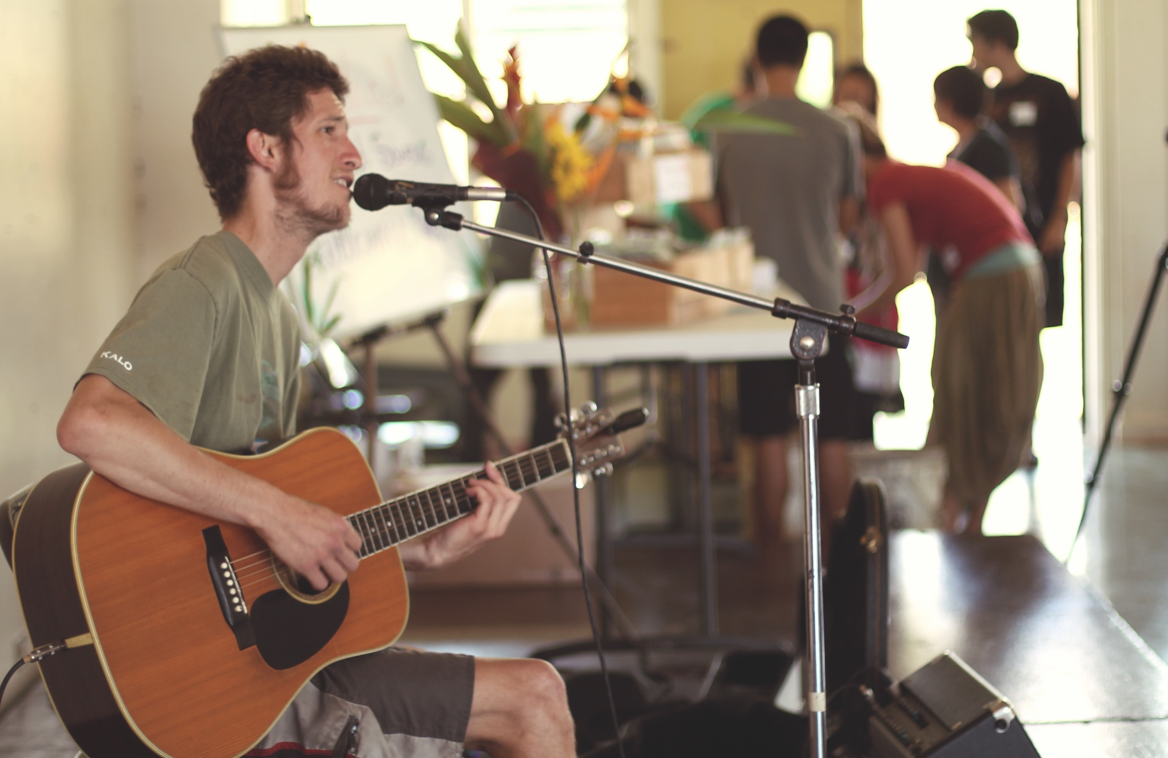

Slide 8
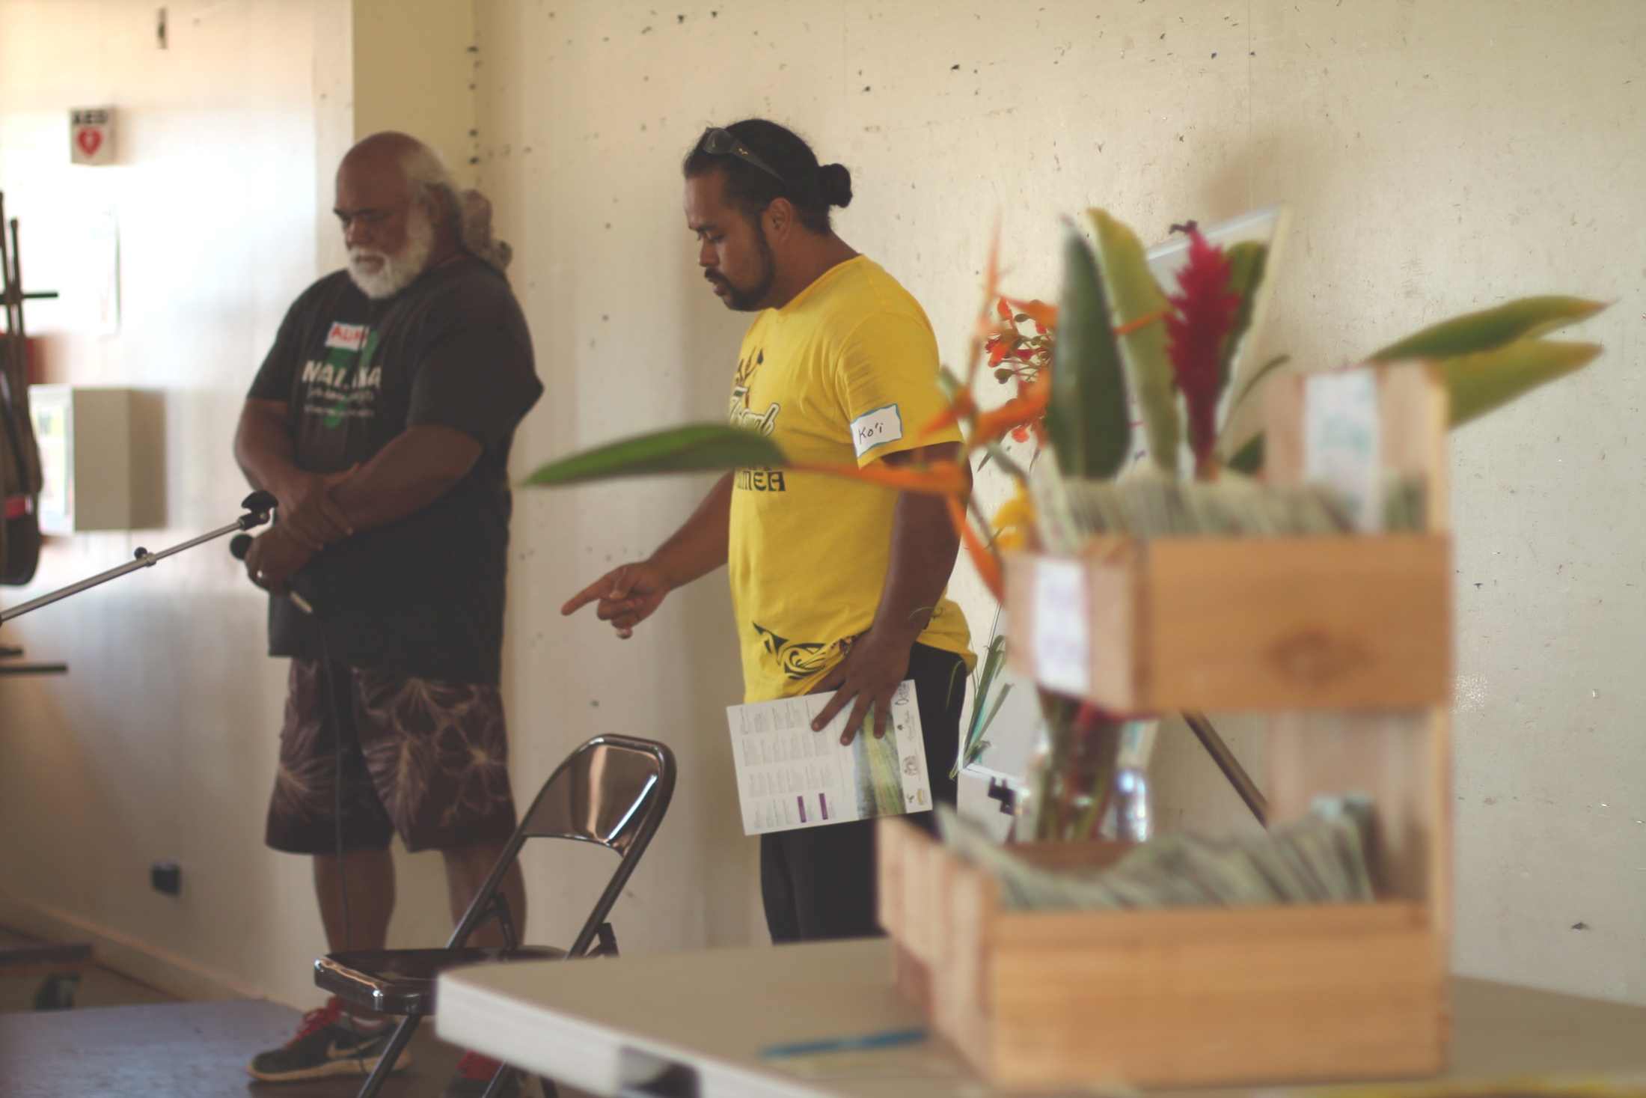

Slide 9
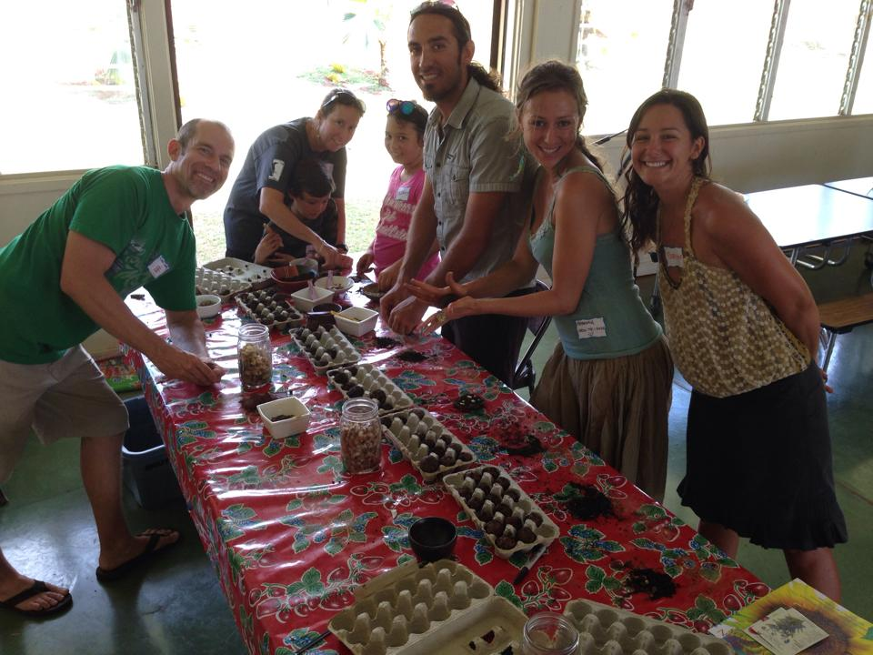

Slide 10
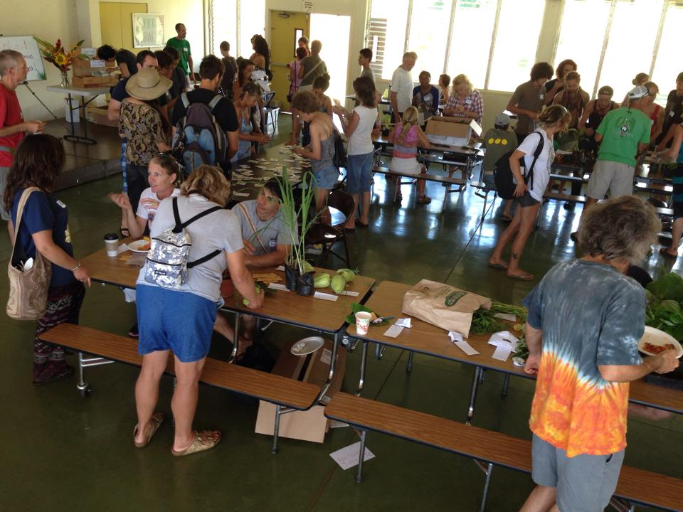

Slide 11
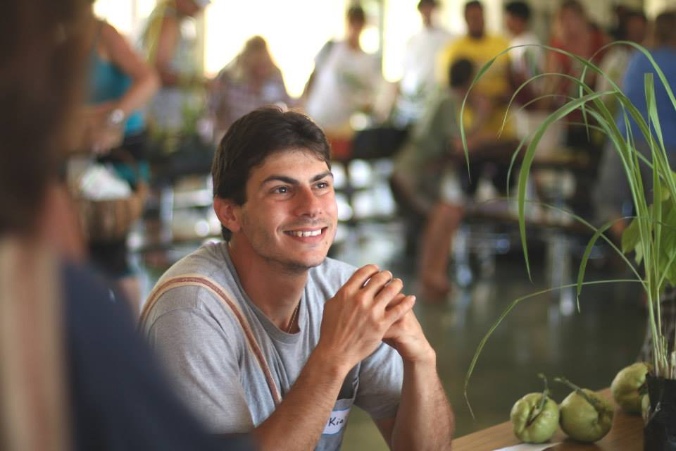

Slide 12
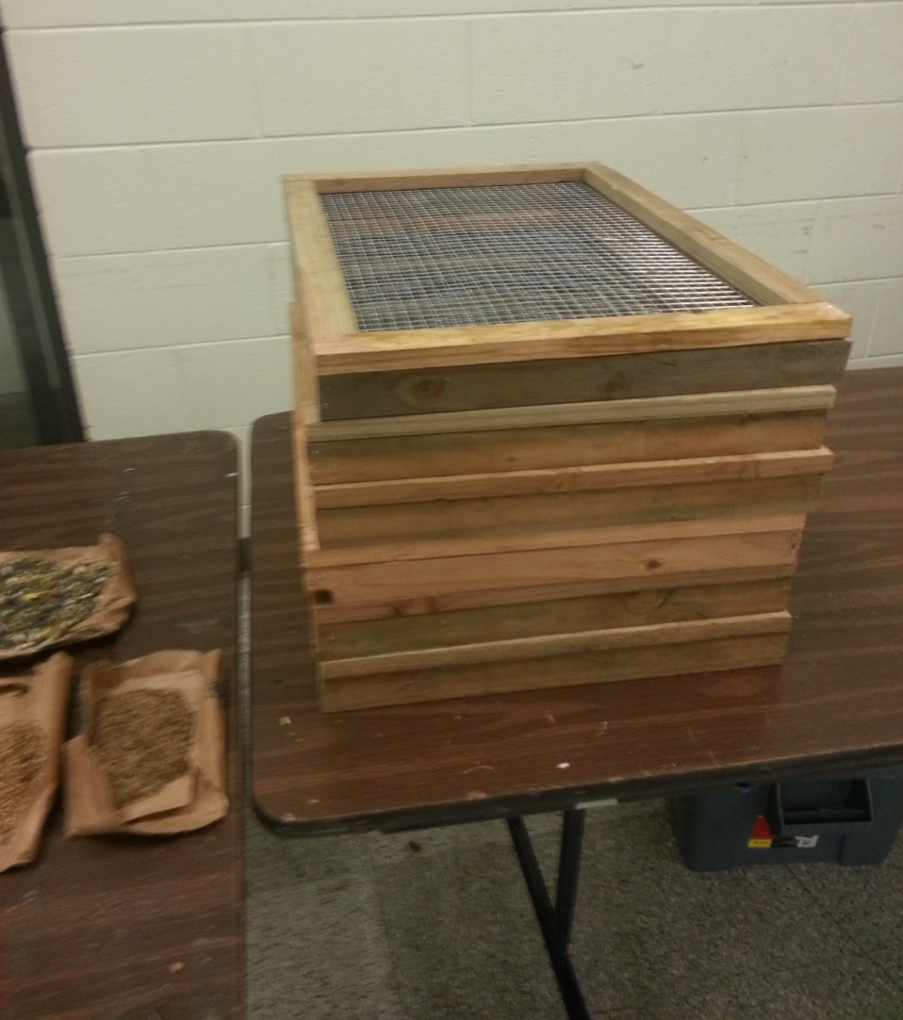
Education and Outreach
Posters
Seed Screens
Website
Facebook
Notes:
Got pics of the poster?

Slide 13
www.mauiseedsavers.com
Notes:
If we are internet connected at the time we can show the site live

Slide 14
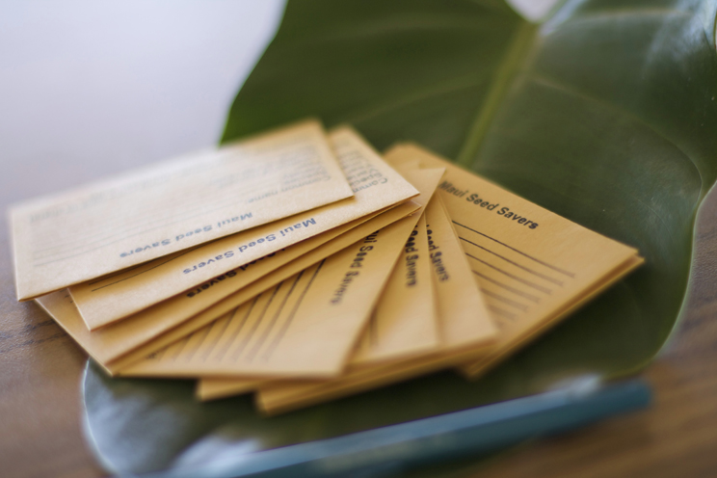
Maui Seed Savers Seed Packs

Slide 15
Dates for future workshops and exchanges
Sept 13th in Kihei with Grow Some Good
October 26th is the Tentative date for the fall Seed and Plant Exchange
TBD - West Maui in collaboration with Alika Atay and the new Westside HFUU chapter
Notes:
TBD East Maui Mahele Farm

Slide 16
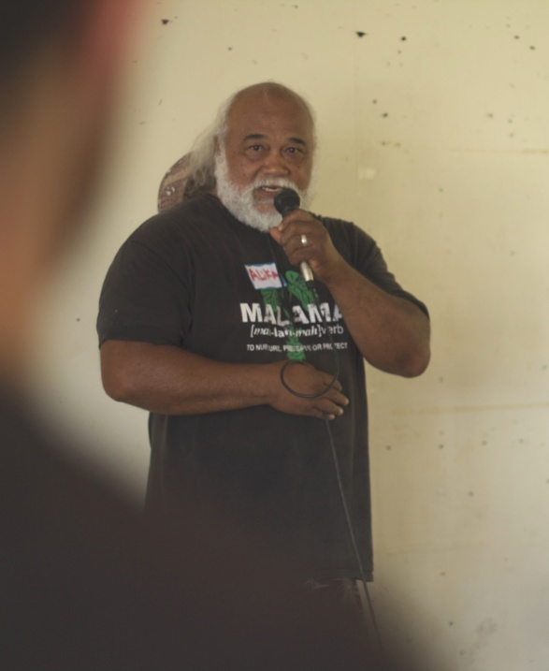
Community partners
And dozens of farmers, local restaurants, and Vendors
Notes:
Upcountry sustainability

Slide 17
Big Mahalo to HPSI for the Mini-Grant

Slide 18
Maui Seed Savers
Evan Ryan
Elan Goldbart

