Slide 1
Upland Taro Production by Glenn I. Teves, County Extension Agent UH CTAHR Cooperative Extension Service - Molokai

Slide 2
In the Beginning …
Taro originated in the Indo-Malaysian Peninsula over 50,000 years ago. Domestication in the Western Pacific occurred independently in many areas prior to Polynesian arrival. Grown in Hawaii for 2000 years, many cultivars are based on mutations. All Hawaiian cultivars can be narrowed to 4-5 original introductions, based on genetic mapping.

Slide 3
Growing Systems
Wetland (lo’i) – a water pass-through system where corms are submerged. Slower maturing.
Upland (mala) – a planting system that’s usually rain-fed and utilizes soil and mulch as growing media. Usually faster maturing.

Slide 4
Mala System - Ho’olehua, Molokai

Slide 5
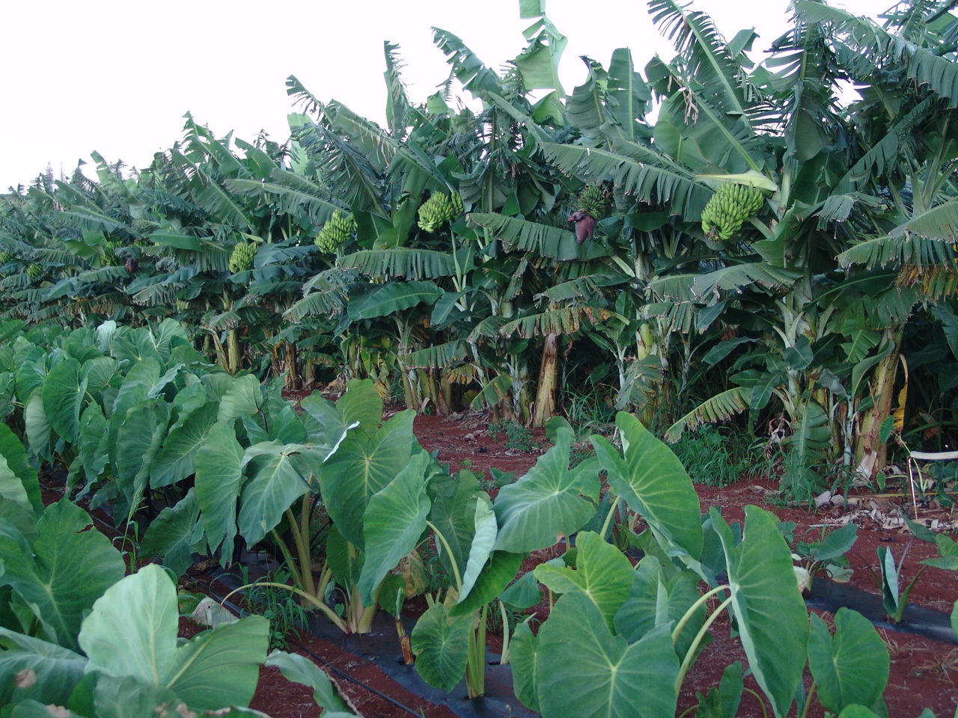
Mala System with Banana Windbreak

Slide 6
Hawaiian Taro Cultivars
It’s estimated that about 90-100 Hawaiian cultivars are left of the 200+ cultivars selected by them. Many cultivars have been lost due to changing eating habits. After end of Kapu System, demand moved to ali’i taro; purple or Lehua types. There are much more white and off-white cultivars than purple ones. Purple color is recessive. (only 7% purple in white cross)

Slide 7
Market Wants Purple Corms

Slide 8
Propagation
Taro is propagated vegetatively. There is a need to preserve ALL of the varieties for future generations, and the only way is through continuous planting or sharing with others have access to huli or planting material

Slide 9
Keiki = Banana Seed
Technical term for banana planting material is a keiki. Similar to huli.

Slide 10
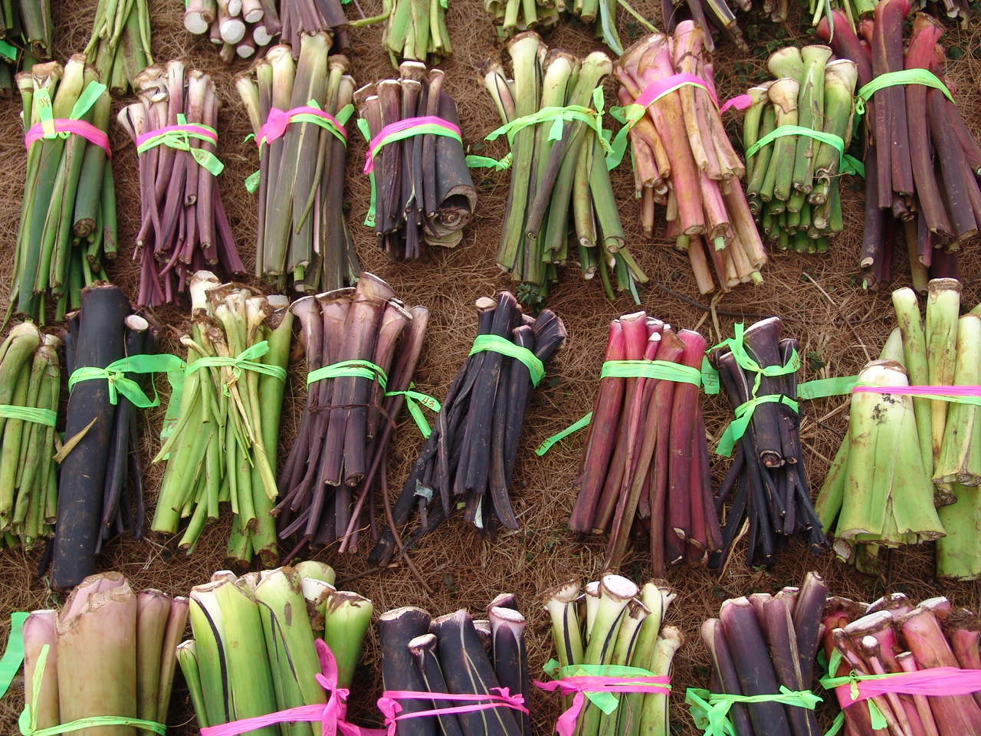
Huli = Taro Seed

Slide 11
Identification Based On:
General characters – height, maturity, unique characteristics
Leaf blade, shape, & orientation
Piko color
Petiole and leaf edge (lihi) color
Apex (kohina) color
Corm fiber and skin color
Inflorescence

Slide 12
Leaf Shape – one of the characteristics used to identify a cultivar

Slide 13
Taro Families
Mana (branching corms) – upland, drought tolerant, rubbery consistency, table or kulolo
Piko (unique leaf shape) – late maturing, can be stored, once very popular
Lauloa (large leaf) – upland, drought-tolerant, large corms, non-acrid, table or kulolo
Lehua (reddish poi) – early maturing, dual-purpose, main poi variety, cannot be stored

Slide 14
Mana ulu - Mana leaf can be identified as long & skinny with upright habit and V connected to the piko. Corms also will branch (mana).

Slide 15
Mana ke’o ke’o – leaf edge (lihi) pinkish with white base. Light stripes.

Slide 16
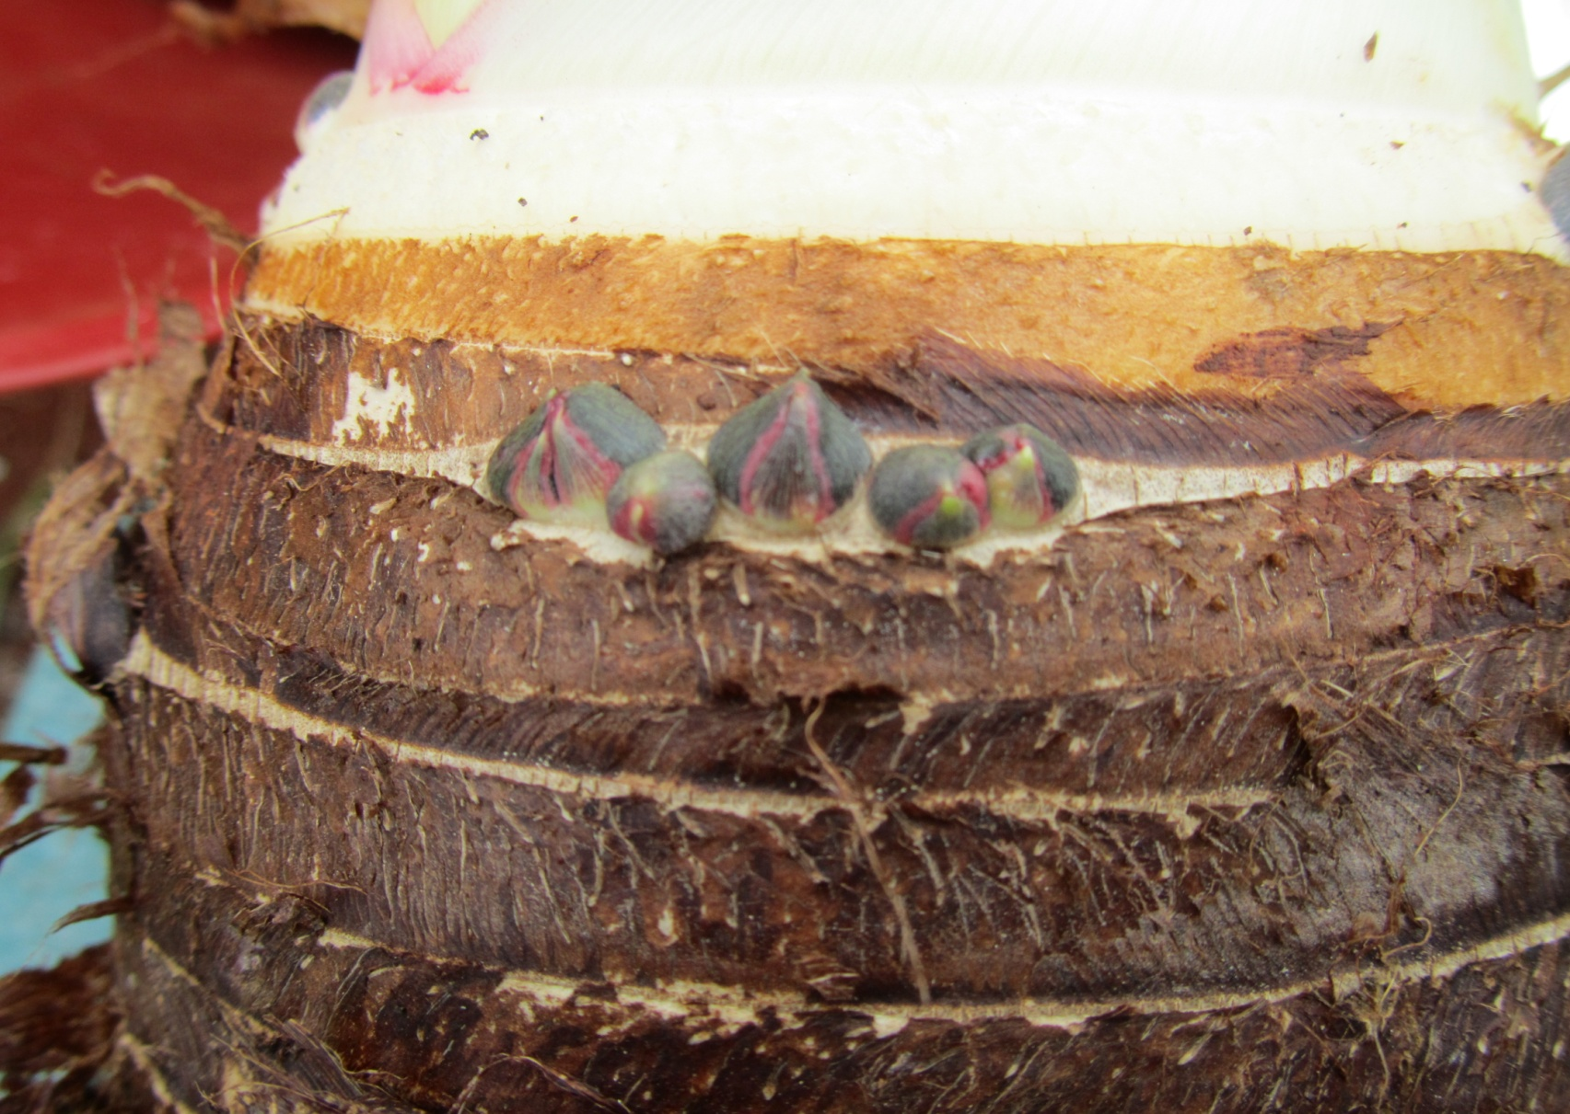
Mana ke’oke’o - Buds (makamaka) in pairs on corm with pinkish stripes.

Slide 17
Leaf Margin (Lihi) - Ele ele naioea broad greenish margins, purple kohina (ring) at base. Lilac-pink near kohina for 3-4 cm upward.

Slide 18
Lauloa – Drought-Tolerant

Slide 19
Lauloa eleele ula

Slide 20
Eleele makoko

Slide 21
Preserving Huli
The key to preserving planting material is to prepare a new planting area before you harvest. This is critical. Another way is to grow huli for planting material.

Slide 22
Growing Huli (Center)

Slide 23
Uniform Huli
Sort huli by size. When using drip irrigation for home use, plant smallest huli closest to water source then plant next largest and so on. Harvest largest from end of line, then tie up line to irrigate the remainder.

Slide 24
Planting Material
Only two ways to have planting material available year-round:
Grow Your Own – Always set aside a few rows for planting material.
Develop a network of growers who share planting material.

Slide 25
Planting

Slide 26
Wetland Poi Varieties
Maui Lehua – purple poi, early maturing, poor storage in field due to rot. (Hanalei)
Moi – excellent taste, can be stored in field, whitish poi, medium maturity. (Maui, Oahu)
Piko uaua – grey poi, can be stored in field, dense corms, late maturity. (Waipio)
Api’i – dense, grey poi (Waipio)

Slide 27
Moi Varieties

Slide 28
Maui Lehua = Lehua maoli hybrid

Slide 29
What Cultivars to Grow
Depends on:
Growing conditions
Use – poi, table, kulolo, or leaf
Luau – Bun long preferred, but any works
Home use – any variety can fit
Early and late varieties – can have taro over a longer period of time.
Availability of planting material

Slide 30
Luau = leaf

Slide 31
Taro Cycle - Upland

Slide 32
Growth Cycle
Example – Mana ulu: 8 month cycle
Month 1: Plant huli – weed control
Month 2-5: Active vegetative growth - plant can grow to 6+ feet
Month 6-8: Active corm growth - height decreases; swelling of corm.
Harvest: Month 8 – height 2-3’

Slide 33
Mana ulu at Harvest

Slide 34
Pa’akala = Ngeruuch (Palau) X Maui Lehua @ 12 mos.

Slide 35
Determination of Harvest Time
Plants will reach its maximum height in 6-7 months for those maturing in 12 months. For 8-9 month varieties, its about 4-5 months.
Plants will start to drop in height and the base of corm (kohina) will start to constrict or close, forming a dome. Huli will be the diameter of a silver dollar where it attaches to the corm.
Can be harvested earlier to allow for time to harvest large fields.

Slide 36
Months to Harvest - Upland
Mana ulu , Lehua ele ele 7-8 months
Pi’i ali’i, Ele ele makoko 8-12 months
Maui lehua, 9+ months
Lauloa varieties 9-12 months
Moi, Mana varieties 10-12 months
Piko varieties 12+ months
This is approximate. Factors include season of planting, windward/leeward, elevation, etc.

Slide 37
Height Determines Yield

Slide 38
What Can Go Wrong?
Leaf Blight, Irrigation Clogging, Weeds, Nematodes, No Seed, Mealy Bugs, Ants, Mites, Slugs, Corm Rot, Storms, Injury, Sickness, Loss of Labor, Water Shortage, New Disease, Wrong Variety, Injury, New Insect, Marketing Problems, Equipment Breakdown, Contamination of Value-Added Product, Quarantine on movement of raw material

Slide 39
Rain + Cold = Leaf Blight

Slide 40
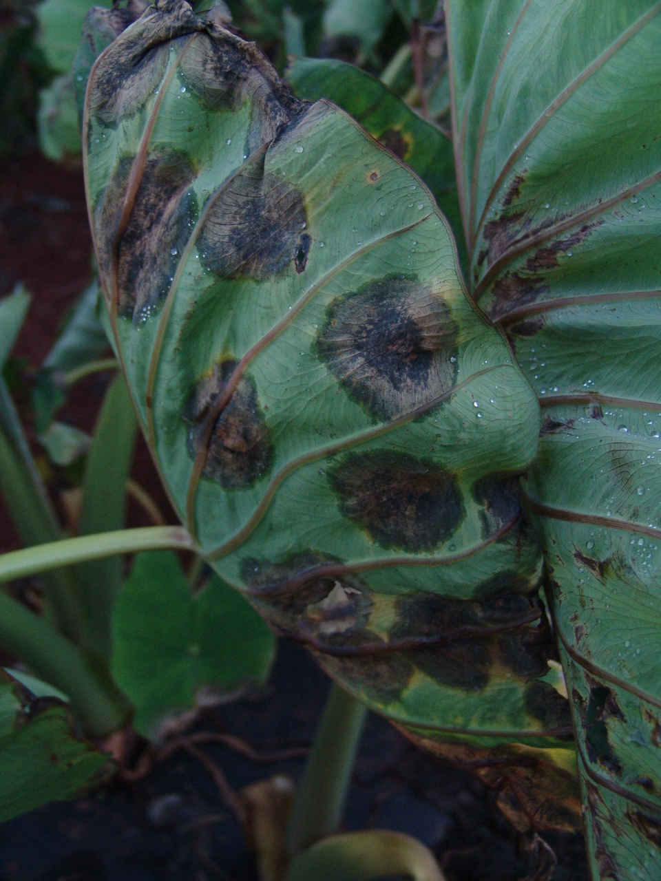
Phytophthora colocasiae

Slide 41
Pros and Cons of Taro Hybrids
Key to developing genetic resistance, especially leaf blight (Phytophthora)
Hybrid vigor resulting in higher yields
Possible loss in poi quality
May gain one resistance and lose another
Genetics not well understood in taro. Not straightforward; unique

Slide 42
Moi X Palau : Piko ulaula : Pauakea

Slide 43
Hybrid 99-4

Slide 44
Selecting Cultivars
Lehua– maoli, Maui, palai’i, ke’oke’o, ‘ele’ele
Mana – ulu, ke’oke’o, lauloa
Lauloa – ke’oke’o, ‘ele’ele ula,
Piko – kea, ke’oke’o, ulaula, uaua,
Eleele – naioea, makoko
Other – Moi, Bun long,
New UH Hybrids – 99-6, 99-7, 99-9, Pa’akala, MP6, 99-33, 2000-141

Slide 45
Mala Weed Control
Your Biggest Challenge!!!
Strategies
Mulches – natural and inorganic
Sterile Seed Bed
Tillage to decrease weed load
Timing of planting

Slide 46
Furrow & Hand-Weeding

Slide 47
Weed Control: Plastic Mulch & Cultivating

Slide 48
Pest Control
The key to pest control is to grow a healthy plant.
Understand pest biology and natural controls, as well as environmental conditions conducive and detrimental to certain pests.
Identify at least a few control strategies for each.

Slide 49
Aphids

Slide 50
Mealy Bugs

Slide 51
Aphids & Mealy Bugs
For Aphids, watch Nitrogen status. High N will attract them.
Fatty soaps, including Safers and Impede
Mix with Diatomaceous Earth for added punch
Control Ants – need attractant + killer. Two types of ants, sugar and protein lovers. Boron is a good killer. Attractant for protein lovers is peanut butter, sugar for sugar lovers

Slide 52
Snails & Slugs

Slide 53
Snails and Slugs
Can be major problem on upland taro. Collect at first rain, like the one that just passed a few weeks ago. Pound nail into tip of old tool handle, and sharpen. Copper is toxic to both; pennies made before 1982 are useful. Iron Phosphide - organic

Slide 54
Root-Knot Nematodes

Slide 55
Pest Stress
Root-Knot Nematode – control strategies include fallow, sunn hemp green manure, crop rotation, increase organic matter.
Mites – good air circulation, wider spacing, resistant varieties, overhead irrigation
Rose beetle – picking at night, neem/DE
Mice/Rats – baiting, plant spacing, thick drip

Slide 56
Windbreaks
Windbreaks are critical to the protection of upland taro, especially in windy areas such as Kohala, Ho’olehua, Kahului, and many areas of the state. Temporary windbreaks such as sorghum-sudan hybrid grass are fast growing, planted by seed, and will protect taro for a year or more.

Slide 57
Sorghum-Sudan Grass Windbreak

Slide 58
Sorghum-Sudan Windbreak
Sow 2 months prior to planting huli. Use hand seed planter with radish seed plate. Can be cut and re-grown (ratoon). Can be used for animal feed or to build soil organic matter. Nematode-resistant

Slide 59
Post-Harvest

Slide 60
When all is said and done,
The Proof is in the Poi

