Slide 1
growing Tomatoes for seed in the hawaiian garden
Glenn I. Teves, County Extension Agent
University of Hawaii College of Tropical Agriculture and Human Resources - Molokai

Slide 2
Thought for the day
“The ultimate goal of farming is not the growing of crops, but the cultivation and perfection of human beings.”
Masanobu Fukuoka
One Straw Revolution

Slide 3
An essential garden vegetable
Tomatoes

Slide 4
Why do
we save
seeds?

Slide 5
eliot coleman Quote #1
“Seeds are the spark of the farm operation, and the more control the grower can exert, the more dependable the system will be”

Slide 6
eliot coleman Quote #2
“For most crops, the vigor and viability of seed grown under careful cultural practices of this production system will far excel seeds that are purchased.”

Slide 7
eliot coleman Quote #3
“I doubt that the direction of present-day seed breeding, selection, and genetic manipulation is favorable to the producer of high quality vegetables …”

Slide 8
In other words …
Grow your own seed:
For better control of your garden or farm.
For better seed quality and vigor.
For your specific environment and needs because no one else will grow them for you.
To cultivate and perfect yourself

Slide 9
vegetablEs from the garden

Slide 10
origins
Tomato, Lycopersicon esculentum is native to the tropical Americas, from Mexico to Chile.
There are dozens of wild Lycopersicon species occupying many environmental niches, from the mountain to the shore, and they are important in transferring genes for fruit quality, pest and disease resistance, and environmental adaptability into the modern tomato.

Slide 11
Plant types
Determinate (bush) – concentrated harvest, short harvesting period. Field production. Ground culture. More wind resistant.
Indeterminate (trellis) – Greenhouse; harvest over long period. High yields, high labor. Usually pruned to a single stem. Susceptible to wind. Can be grown on the ground but unwieldy.

Slide 12
Determinate grape tomato Sugary & aria

Slide 13
Pest resistance
Tomato has the genetic base to create a cultivar with resistance to most of the pests for a specific locale, although some diseases are problematic and difficult to control. i.e. Late blight.
Some diseases are difficult to control due to man’s bad habits. i.e. lack of crop rotation, incremental plantings, lack of crop-free period. Imposing crop-free period is one strategy to keep a disease at low levels. i.e. Spotted wilt virus

Slide 14
Basis of resistance
Wild Lycopersicon species:
L. peruvianum - early blight, leaf mold, fusarium wilt, septoria leaf spot, nematodes
L. hirsutum – early blight, bacterial speck, root-knot nematodes, natural insecticide, hairs create physical barrier for mites
L. pimpinellifolium (currant)– bacterial wilt, fusarium wilt
L. cerasiforme – short stigma = less out-crossing, more true-to-type, heat tolerant
L. cheesemanii – heat & salt tolerance, high vitamin C, jointless pedicels,

Slide 15
Grape & mini-roma tomatoes sugary / juliet / aria

Slide 16
baSIS OF SELECTION
Each seedling is an individual with the potential to possess genes unique from its siblings. Genes will be expressed under certain conditions. i.e. heat stress, low input, disease pressures, heavy rains, high clay soil, low day & night temperature differential, high humidity, etc.

Slide 17
Disease Symptoms

Slide 18
Diseases of tomato in hawaii
Tomato Yellow Leaf Curl Virus – NEW
Tomato Spotted Wilt Virus
Pepper Mottle Virus
Tobacco Mosaic Virus
Early Blight & Stem Canker– Alternaria
Late Blight – Phytophthora
Leaf Mold – Fulvia
Stemphylium – Grey Leaf Spot
Fusarium & Verticillium Wilt
Root-Knot Nematodes
And many more…

Slide 19
Root-knot nematodes

Slide 20
Tomato TSWV/TYLCV Resistance Trial UH ctahr Poamoho Exp Stat. - Oct 2011
# Variety Source Fruit
1 VT-60783 Zeraim Gedera Globe
2 72767 Nirit Grape
3 8466 Nirit Roma
4 Felicity Hazera Cherry
5 Olivia Hazera Grape
6 Ofri Hazera Globe
7 72835 Nirit Baby Roma
8 72061 Nirit Globe
9 72205 Nirit Globe
10 Tymothy Hazera Cherry
11 VT-60773 Zeraim Gedera Globe
12 7105 Nirit Globe
13 HA-46204 Hazera Baby Roma

Slide 21
Tylcv Virus resistance tissue blot test

Slide 22
Hawaii’s needs
Our needs are very unique. We have diverse climates, over 140 soil types, and a year-round growing season with year-round pests. Our plants face extremes; drought, heat, heavy rain, and high humidity, creating conditions for diseases of all kinds. Cultivars must be acclimated to high night temperatures if grown in low lands.

Slide 23
Breeding considerations
Fruit Quality Evaluations:
Shape Firmness
Color Shoulder shape
Gel color Core
Wall thickness Taste
Clusters Pedicel type
Blossom end Stem end

Slide 24
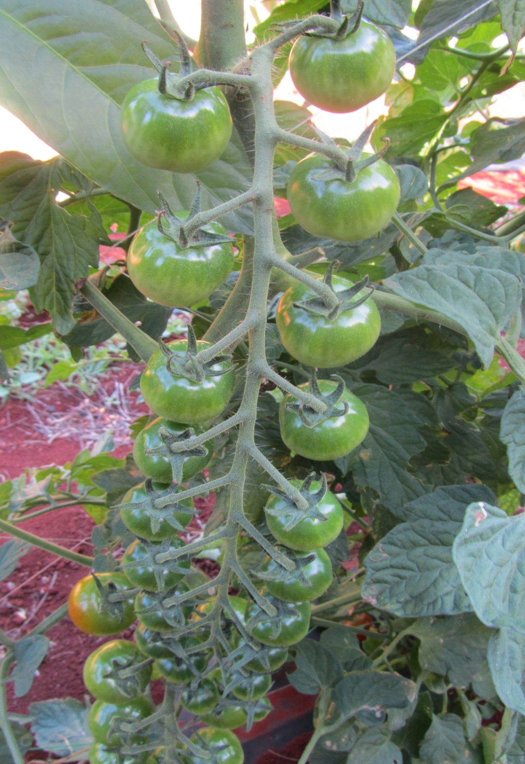
Cluster
Types

Slide 25
Breeding considerations
Free from the following defects:
Cracking
Cat-facing
Puffiness
Blossom-end rot
Zipper fruits
Nipple tips
Blotchy ripening
Grey wall

Slide 26
Breeding considerations
Plant: canopy (sun scald), habit (determinate and indeterminate), compactness
Diseases: fungus, bacteria, virus, physiological
Other: nutrition, pesticide-free, organic vs. conventional

Slide 27
Breeding objectives
Priorities constantly changing. Trends include nutrition. Breeders attempt to combine quality and disease resistance into one compact plant. Regional breeding, but should be more site-specific, especially in Hawaii.
Pest resistance: Focus on major diseases based on crop loss. Many site-specific problems in Hawaii due to diverse climate and conditions, even between islands. Need to identify pests in your area and identify cultivars with resistance to your problems.

Slide 28
Regional breeding
Southern Tomato Exchange Program (STEP)
Each state bred for their own problems, then included accessions from other states as part of side-by-side tests. Crossing with accessions from other states to develop a well-rounded tomato from unrelated lines. i.e. Crossing a disease-resistant line with a high fruit quality line. Ended in the late 1990’s. Few active programs left – Florida, North Carolina, Oregon, Penn State, Ohio State, Michigan State, UC Davis, Cornell, others.

Slide 29
‘Indigo Rose‘ jim myers – Oregon State

Slide 30
Problems in breeding
Good genes are tightly linked to bad genes, and you need to break the linkage through selection. Examples include Root-nematode resistance and cracking, Tobacco Mosaic Resistance and soft fruit. May have to plant thousands of seedlings before you can find one with only the favorable gene.

Slide 31
Breeding today
Breeding has become very complicated:
Using genetic markers to find a mass of good genes. A good tomato must have many good genes, not just a few.
Not enough time to find one good gene at a time. Finding two good parents with four good genes from each parent will give you eight good genes in a hybrid. Some diseases require resistance from both parents. i.e. TMV

Slide 32
Sorting tomatoes for ripeness and color

Slide 33
What does The commercial Hawaii Farmer want
Yield – high pack-out and grade-out $$$
Concentrated set (field production) $$$
Sustained production (greenhouse) $$$
Pest and Disease Resistance $$$
Vigor-fast germination & quick growth $$$
Shelf-life/Standability: non-cracking, firm fruit, Rough Handling $$$
Appearance – glossy, appealing to the eye $$$

Slide 34
Gardeners considerations
Nutrition
Eating Quality – balance of sweet & sour
Harvest over long period of time
High genetic variability – can select for resistance to problems, seed can be saved
Multiple Disease resistance
Efficiency in fertilizer use – not high input
Large Root System – ability to withstand stress, late maturing
Adaptable to Tropical Conditions – heat, rain, warm nights

Slide 35
The ideal garden tomato
Nutrient rich fruit
Excellent taste – explodes in your mouth!
Late maturing – produce a large scavenging root system to sustain plant over a long fruiting season – 3+ months
Utilizes nutrients efficiently = low input
Adapted to tropical conditions: Heat & rain
Resistance to many diseases found in Hawaii – V,F123,N,T,A,TYLCV
Vigorous growth/genetic variability

Slide 36
Selecting varieties
Eliot Coleman’s List of Priorities (Modified):
Eating Quality Appearance
Pest & Disease Resistance Vigor
Days to Maturity Performance
Standability Ease of Harvest
Time of Harvest Adaptability
Ease of Cleaning Convenience
Ease of Preparation Nutrition
Marketability

Slide 37
Breaking FI hybrids
A novel way of developing a disease-resistant inbred for your area. Save the seeds from a F1. You may want to take fruits from several fruits instead of one. More variability since F1’s are segregating for certain resistance. Plant at less-than-ideal times to express genes, then select what you want. If the disease is not present, you may not capture resistance in your selection. Overcome nematodes by grafting onto resistant rootstock.

Slide 38
Nematode-resistant tomatoes
Celebrity – F1
Carnival – F1
Milagro – F1
Empire – F1
Healani
Anahu
Abe Lincoln
Apero (cherry)
Favorita (cherry)
Beaufort (rootstock)
Maxifort (rootstock)

Slide 39
Field trials
Allow you to identify superior cultivars for your area for that season.
Will show you what diseases you have in the area for that season.
Will only tell you which cultivars grow well in that season or time slot.
Keep the best and use to compare to new ones next season.
Train your eyes to the intricacies of the different characteristics.
Invite your friends to help evaluate. Everyone sees things differently.
Know what you’re looking for.

Slide 40
Field trials – may 2012

Slide 41
Trellis tomato trial in progress
Juliet : Known You (Taiwan), 30g red mini roma
Aria: Known You (Taiwan), 16g orange grape
Golden Gem: KY (Taiwan), 20g yellow cherry
72835: Nirit (Israel), 30-40g baby roma
72767: Nirit (Israel), 20-30g red cherry (N)
Hanipssok 601: (Korea Seed), 30g red cherry
First Love: Hazera (Israel), 16g yellow grape
Love Song: Hazera (Israel), 30g red grape (N)
Olivia: Hazera (Israel), 16g flattened red grape
Vittoria: Hazera (Israel), 20g mini-San Marzano (N)

Slide 42
Trial challenges
Powdery mildew – 1 cultivar
Russet mite – 2 cultivars
Corn earworm – low populations (Dipel)
Low nutrition, especially Magnesium deficiency – high density planting

Slide 43
Powdery mildew

Slide 44
Russet mite damage

Slide 45
Russet mite symptoms

Slide 46
Know your soil limitations - magnesium deficiency

Slide 47
Seed Production ctahr volcano research station

Slide 48
Healani tomato
Resistance to:
Tobacco Mosaic Virus
Root-knot nematodes
Vascular browning from still, wet weather
Fusarium Wilt
Stemphylium
Alternaria
Others

Slide 49
Healani tomato

Slide 50
Hydroponic Media

Slide 51
green onion seed - Koba

Slide 52
Green Onion Seed

Slide 53
Koba Green Onion Seed

Slide 54
Happy seed saving !

Slide 55
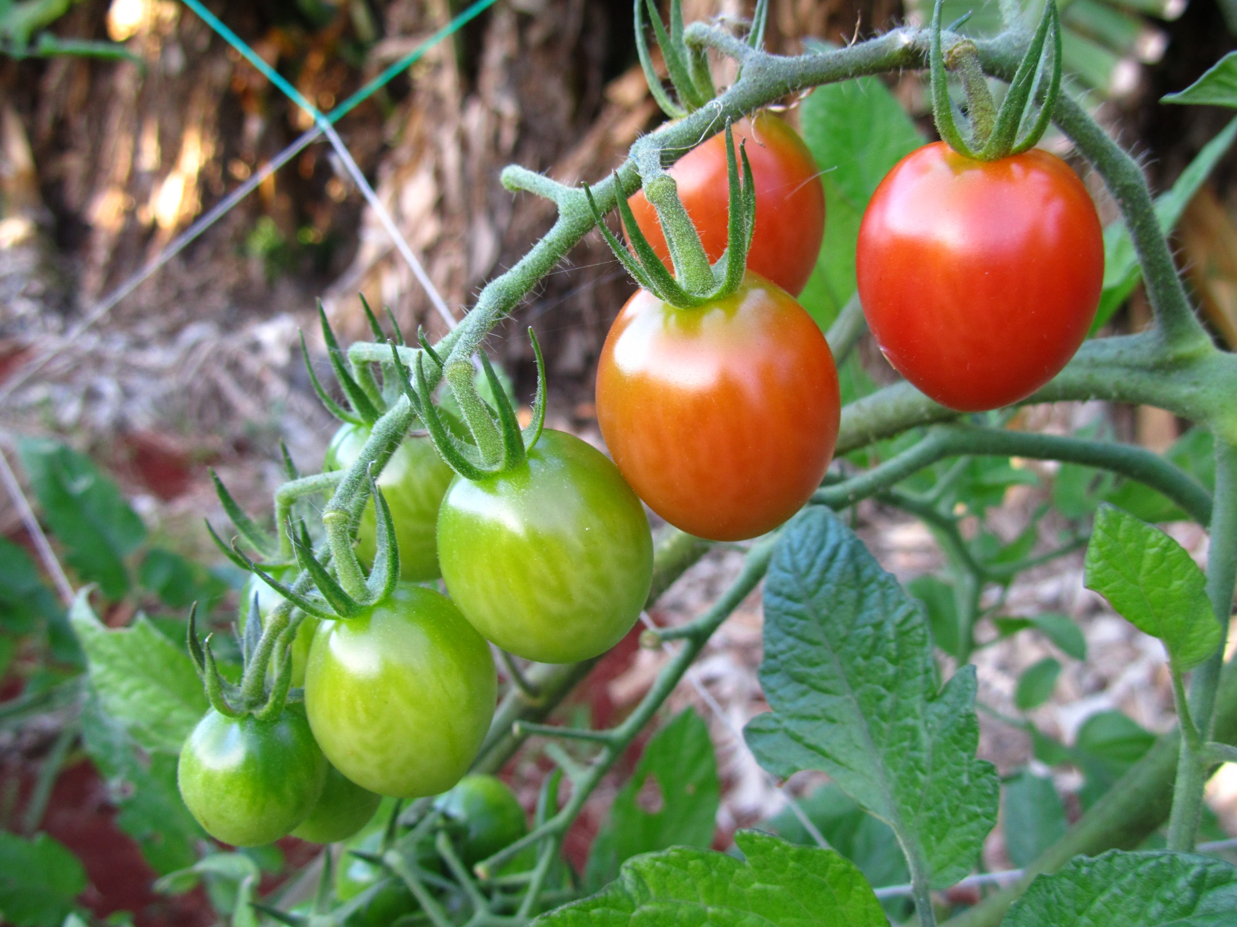
The End

