Slide 1
Hawaiian Heirloom Sweet Potatoes Jay Bost TPSS University of Hawaii
1789 watercolour by Delahaye

Slide 2
Hawaiian Heirloom Sweet Potatoes
Problems
Opportunities
Hawaii’s dependence on imported food
Ex situ collections of sweet potato understudied and poorly characterized
Agronomic and nutrition qualities of Hawaiian sweet potato varieties poorly researched
Yields may not be as high as modern varieties
Low public understanding of the diversity of sweet potatoes
Find appropriate staples adapted to Hawaii
Characterize, rationalize, and make database of varieties
Trail varieties in various settings and analyze nutrition
Maximize value by nutrition, quality, story, organic, etc
Through tastings and participatory variety trials raise awareness

Slide 3
Sweet Potato
7th food crop globally
Former staple in Hawaii
In Hawaii since ~1300s AD
Grows in marginal conditions
Potential contributions to Hawaii’s food security:
carbohydrate
animal feed
flour/noodles

Slide 4
Sweet Potato’s spread around the world
Roullier et al 2013

Slide 5
Hawai’i appears to have some unique Polynesian germplasm
Roullier et al 2013

Slide 6
Sweet Potato in Hawaii
2nd staple after taro
Enabled expansion of agriculture into drier areas
Estimated production:
182,240 acres
2.2 tons/acres
812million/lbs (Ladefoged et al 2009)
Cultivar diversity:
Rooke (1855): 50 vars
Chung (1923): 70 Hawaiian named, 200 others
Handy (1930s): 260 vars., 24 commonly cultivated
Breeding by UH since 1917
Played important role during both WWs
Handy 1930s

Slide 7
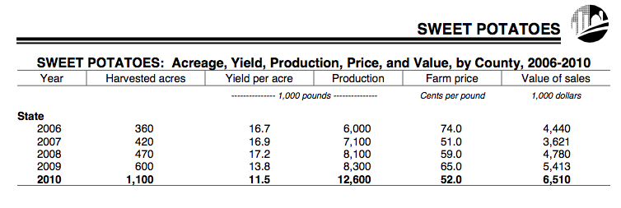
Sweet Potato today
2008: Hawaii produced 8,100,000 lbs and imported 1,616,000 lbs
2011: 10th most valuable crop
Worth $7.4 million
Varieties: Okinawa, Ho’olehua Red
90% of production on Hamakua coast
Continuing introduction of varieties

Slide 8
Future looks bright..
”This is a "star" crop for Hawaii and demand had been growing exponentially.”
-Matthew K. Loke, Ph.D.
UH/HDOA, May 1st, 2013

Slide 9
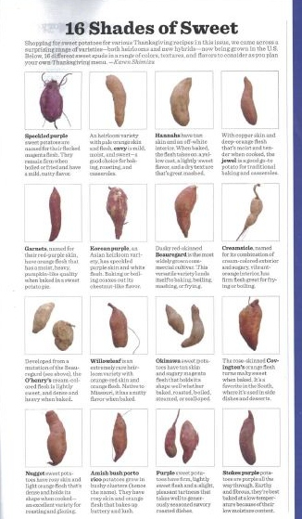
What is here today?
Increasing interest in local food and food with a story make an opportune time
Conservation through utilization
Share Hawaii’s genetic diversity
with the world
“it would not be adaptive to
eliminate alternatives [which]
might never be recovered..”
(Boster 1984)

Slide 10
Collections of sweet potato in Hawaii
Bishop Museum (small and recent)
Waimea Garden (largest, well curated)
Lyon Arboretum (medium)
Maui Nui Garden (large, well curated)
Hui Ku Maoli Ola/ Papahana Kuaola (large, poorly curated)
National Tropical Botanical Garden (Kahanu) (?)
Operating independently
Coordination would be interesting and useful
Meilleur estimated 25-30 remaining Hawaiian vars (1998)

Slide 11
What do “traditional” varieties of sweet potato have to offer for food security in Hawai’i?
Thus far Hawaiian varieties have been largely overlooked or ignored.
Look for potential varieties that have high market value
Superior nutrition
Hawaiian heirloom
Superior taste qualities
Perform in organic systems
http://www.k12.hi.us/~sdrown/plantweb/uala.htm

Slide 12
Step 1: assemble collection
Already have ~50 lines (including probable duplicates)
15 Hawaiian named
14 unnamed potentially Hawaiian
One very strong candidate as ancient genotype: papa'a kowahi
3 non-Hawaiian heirlooms
In May collect from Maui Nui Botanical Garden and NTBG
Research and write history of sweet potato in Hawai’i including review of past UH research

Slide 13
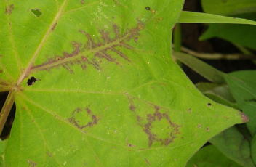
Test for Viruses in Clones
SFMV-
potyvirus
(S. Fuentes & L. Salazar).
Subset has tested negative for Potyviruses
Test clones on indicator species (Ipomoea setosa)
Attempt to verify material as clean (and/or clean it)
Are yields suppressed by asymptomatic infection?
For safe on island and off island distribution
(J. O'Sullivan)
Sweet potato chlorotic stunt virus (SPCSV) (genus Crinivirus, family Closteroviridae)
Gemniviruses?

Slide 14
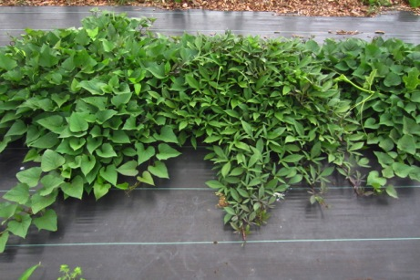
Step 2: Observational Trials
Plant following cover crop of Sorghum-Sudangrass Hybrids Sorghum bicolor x S. bicolor var. sudanense
Attempt to standardize nutrient levels with organic fertilizer application
Attempt to standardize water through evapotranspiration calculations
2 plantings Sept 2013/April 2014
Non-replicated trials of 10 plants in Waimanalo and Poamoho

Slide 15
Observational trials
Characterize all accessions using morphological characters from IBPGR descriptors
Measure dry matter, protein, starch, total sugars, carotenes, anthocyanins, phenolics, trypsin inhibitors
Photograph to create “guide” along lines of taro

Slide 16
Select varieties for further work
Field day with tastings and tastings organized tastings.
Nutritional qualities
Yield
Weed competiveness
Days to maturity
Disease resistance
Sweet potato scab
Reniform nematodes
Weevils
Java black rot
Scurf
Flea beetle (Chaetocnema confinis)

Slide 17
Potential Genetic Work
Use SSRs to find chloroplast halpotype and nulcear genepools of my “new” collections
Potential collaboration using AFLPs
Identify potential ancient Hawaiian vars. and to identify duplicates.
Identify clonal lineages
“Rationalize collections”
Roullier et al 2013

Slide 18
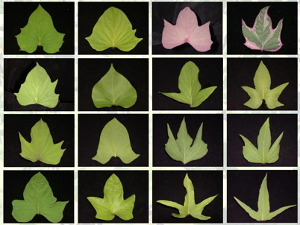
Step 3: Advanced Trials of most promising varieties
Randomized complete block/ 3 replications
Following cover crop of sudex under organic conditions
Waimanalo and Poamoho
http://www.npgrc.tari.gov.tw/npgrc-web/page-picture/diversity/sweet_potato.jpg

Slide 19
3rd participatory trials
Subset of varieties in advanced trials made available to:
Farmers
School gardeners
Master gardeners
Purposes:
Generate data on adaptability
Educational tool to raise awareness of diversity AND of how to participate in trials

Slide 20
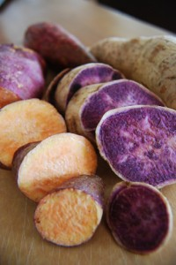
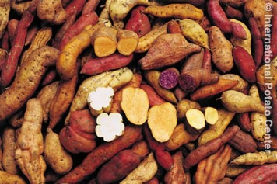
Goals:
Identify promising cultivars for small scale farmers and gardeners of high value and/or unique interest
Document existing diversity in ex situ collections and aid in “rationalization” of collections and statewide database
Raise awareness of Hawaii’s unique role in global sweet potato diversity
Serve as source for characterized, disease free material
Global Crop Diversity Trust

Slide 21
Dissertation
Chapter 1: Review of sweet potato history in Hawaii
Chapter 2: Morphological and nutritional characterization of Hawaiian varieties from ex situ collections
Chapter 3: Molecular characterization using SSRs of Hawaii’s ex situ collections
Chapter 4: Performance of selected clones in organic systems
Chapter 5: Participatory sweet potato variety trials and citizen science in Hawaii

