Slide 1
Hand Pollinating Squash

Slide 2
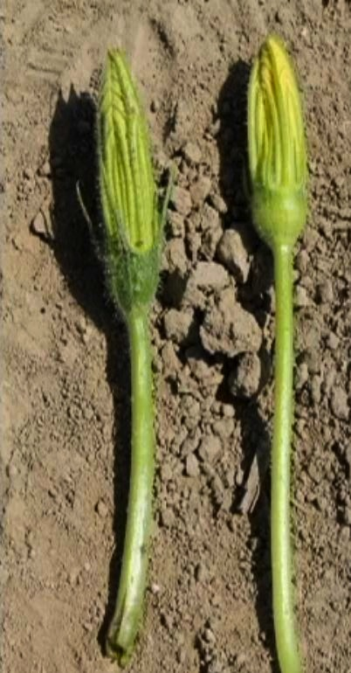
Male & Female Flower Morphology difference
Notes:
The female flower on the right side has a small bulb (flower ovary) beneath the petals that looks like a tiny fruit. The male flower on the left does not have this small fruit looking structure.

Slide 3
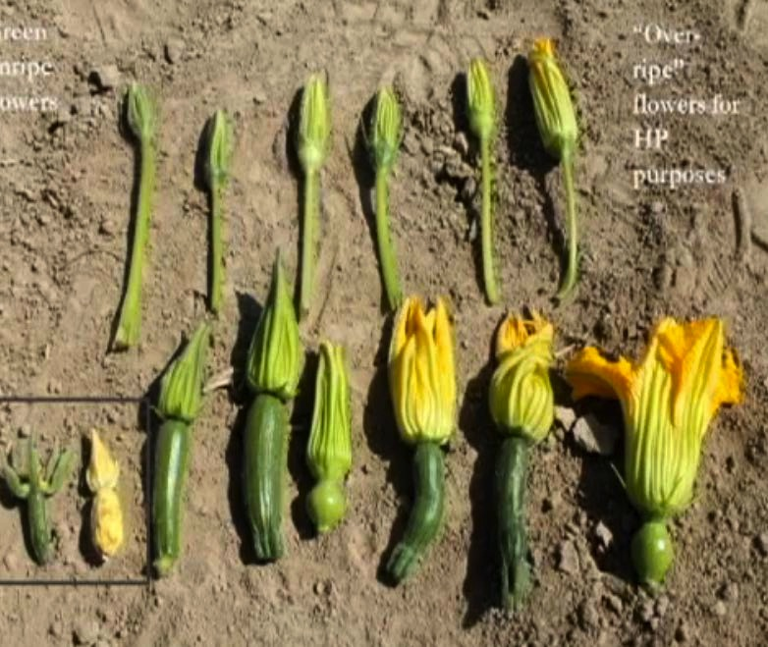
Differences in Male/Female Flower Morphology in Different Species of Squash Family
Notes:
Male flowers are exhibited on the top row and the corresponding species of female flowers are on the bottom row. Female flowers exhibit small fruit structures below their petals. Male flowers do not have these structures.

Slide 4
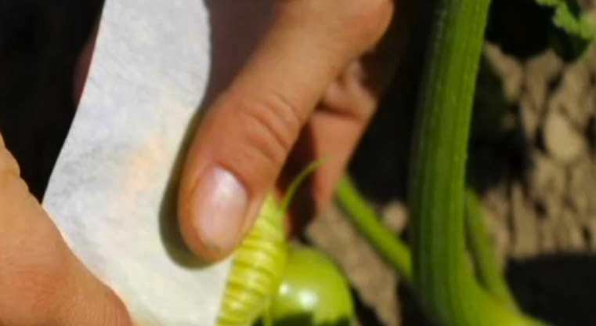
Notes:
In the evening choose a female blossom that has not been pollinated and is still tightly closed but looks like it will be ready to open in the morning. Tape the flower petals closed with masking tape or first aid adhesive tape.

Slide 5
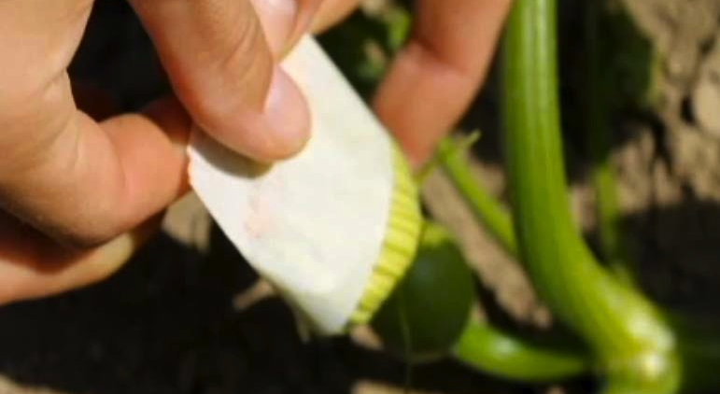
Taping the Female Flower
Notes:
Securely taped female flower.

Slide 6
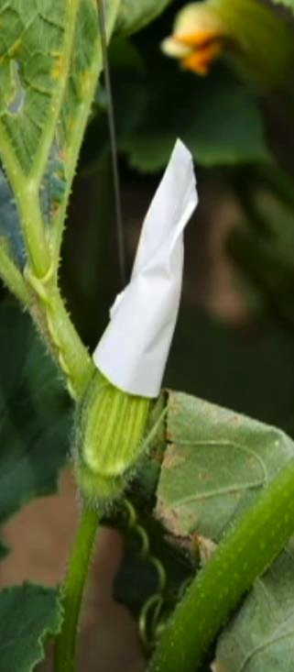
Taped Male Flower
Notes:
Chose a male flower that has not opened but will be ready to open in the morning and tape the petals securely . closed

Slide 7
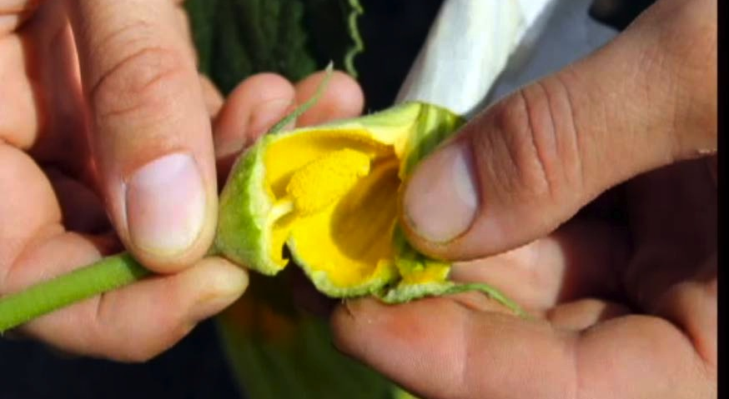
Readying the Male Flower for Pollination
Notes:
First thing in the morning find your taped male flower and holding the tape in one hand and the stem in the other hand, carefully strip the petals from the male reproductive parts (pollen covered anthers).

Slide 8
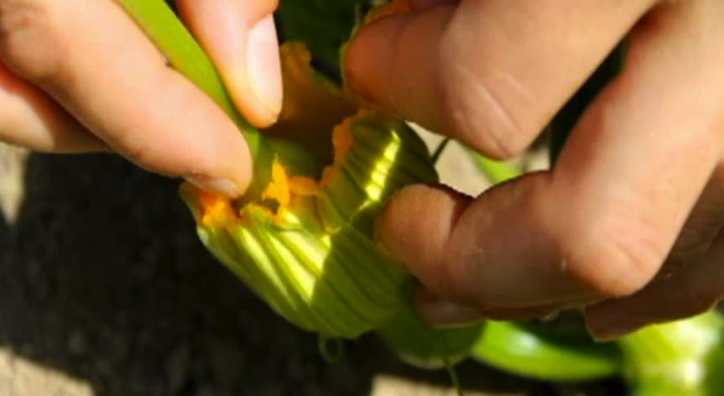
Pollinating Female Flower with Male Pollen
Notes:
Early in the morning, before most pollinators are out, find your taped female flower gently remove the taped tips of the blossom, leaving the petals intact as much as possible). Working quickly so no insects get to the female flower, Holding your male flower by the stem, using it like a brush, dab the pollen-covered anthers of the petal-less male flower onto all 4 of the stigmatic surfaces of the female flower.

Slide 9
Tie the petals of Female Flower
Notes:
Securely tie the remaining petals of the female flower so that no insects can intrude and pollinate the flower.

Slide 10
Female Flower Pollinated and Tied

Slide 11
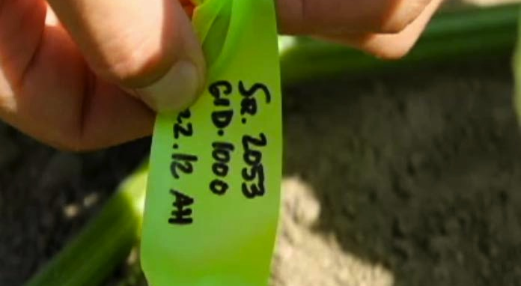
Label The Pollinated Female Flower
Notes:
Most importantly label the flower you just pollinated with the date pollinated, the number of the female pollinated (1 out of 10 etc) and any other information. Use a durable plastic tape such as surveryors tape and tie it onto the stem below the flower (not on the flower petals). The taped flower will drop off as the pollinated fruit grows and matures.

